Slide 1
UNIT 8: WIDE AREA NETWORK
LH-4
ROLISHA STHAPIT

Slide 2
CONTENTS
Introduction; Dedicated-Circuit Networks (Basic Architecture, T-Carrier Services, SONET Services); Packet-Switched Networks (Basic Architecture, Frame Relay Services, IP Services, Ethernet Services); Virtual Private Networks (Basic Architecture, VPN Types, How VPNs Work); The Best Practice WAN Design; Improving WAN Performance (Improving Device Performance, Improving Circuit Capacity, Reducing Network Demand).

Slide 3
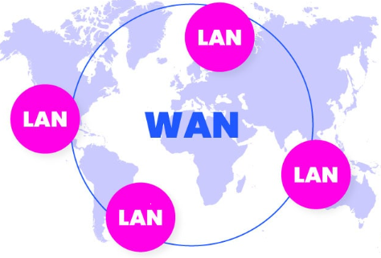
Introduction
A Wide Area Network (WAN) is a type of computer network that covers a broad area, such as a city, country, or even spans across continents. Unlike Local Area Networks (LANs), which are limited to a single building or a campus, WANs allow computers and devices in different locations to be connected and communicate with each other. WANs are often used by large organizations, businesses, and government entities to facilitate the exchange of data and information between their various locations.

Slide 4
The WAN networks are often established by service providers that then lease their WAN to businesses, schools, governments or the public. These customers can use the network to relay and store data or communicate with other users, no matter their location, as long as they have access to the established WAN. Access can be granted via different links, such as virtual private networks(VPNs) or lines, wireless networks, cellular networks or internet access.
For international organizations, WANs allow them to carry out their essential daily functions without delay. Employees from anywhere can use a business's WAN to share data, communicate with coworkers or simply stay connected to the greater data resource center for that organization. Certified network professionals help organizations maintain their internal wide area network, as well as other critical IT infrastructure.

Slide 5
Characteristics of WANs:
Geographical Scope: WANs cover a wide geographical area, connecting LANs in different locations, such as offices, branches, or campuses spread across cities, states, or countries.
Public and Private Networks: WANs can operate over public networks, such as the Internet, or private networks, such as leased lines or dedicated connections provided by telecommunication companies. Private WANs offer more control, security, and reliability compared to public WANS.
Infrastructure: WANs use a variety of communication technologies, including fiber-optic cables, satellite links, microwave connections, and other high-speed data transmission mediums to establish connections over long distances.
Networking Devices: WANs use devices such as routers and switches to direct data packets between different networks and ensure that they reach their intended destinations.

Slide 6
Protocols: WANs use network protocols, such as TCP/IP (Transmission Control Protocol/Internet Protocol), to enable communication and data exchange between devices on the network.
Connectivity: WANs facilitate various types of connectivity, including point-to-point connections, where two specific points are connected directly, and point-to-multipoint connections, where multiple points are connected to a central location.
Applications of WANs:
Enterprise Connectivity: WANs are essential for connecting branch offices, enabling seamless communication and collaboration.
Internet Access: Internet Service Providers (ISPs) use WANs to provide internet access to customers over vast geographical areas. Cloud Computing: WANs facilitate access to cloud-based services and resources, allowing businesses to store data and run applications in remote data centers.
Telecommunication: Telecommunication companies use WANs to provide various services, including voice calls, video conferencing, and internet connectivity.

Slide 7
Dedicated Circuits Network
A dedicated-circuit network is a separate point to point data-communication route between communicating systems. It is available to employ at any time by a designated user. The circuit may be either physical or logical. The physical one is just a cable used to create permanent link between two devices. In such case the network is typically a leased line frequently used to create private wide area networks. Logically dedicated circuits exist as a virtual part of switching networks such as the Internet, frame relay and ATM networks.
Dedicated-circuit networks remain essential for businesses and organizations that require reliable, high-performance, and secure connections between their various locations. However, due to their costs and limitations in scalability, organizations often evaluate other WAN options, such as Virtual Private Networks (VPNs) and MPLS, based on their specific requirements and budget constraints.
With a dedicated-circuit network, the user leases circuits from the common carrier for his or her exclusive use 24 hours per day, 7 days per week. It is like having your own private network, but it is managed by the common carrier. Dedicated-circuit networks are sometimes called private line services.

Slide 8
Advantages:
Reliability: Dedicated-circuit networks offer high reliability as the connection is dedicated solely to the organizations using it, minimizing the chances of congestion or network failures.
Predictable Performance: The fixed bandwidth ensures predictable and stable network performance, allowing businesses to plan their operations effectively.
Security: Because these lines are private and leased specifically for the organization, the data transmitted over dedicated-circuit networks is generally more secure than data sent over public networks.
Disadvantages:
Cost: Leased lines can be expensive, especially for high bandwidth requirements, making them less cost-effective compared to other WAN technologies like VPNs over the internet.
Scalability: It can be challenging and costly to scale the bandwidth of dedicated-circuit networks, especially if substantial increases in capacity are needed.

Slide 9
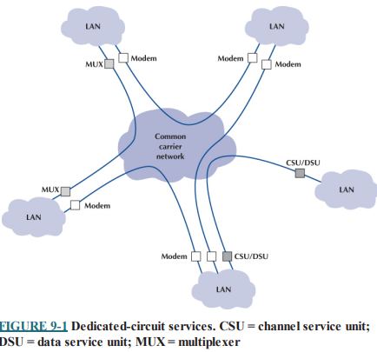
Basic Architecture:
The basic architecture of dedicated circuit networks involves the use of leased lines to establish a direct, private, and constant connection between two or more points. A dedicated-circuit network is a separate point to point data-communication route between communicating systems. It is available to employ at any time by a designated user. The circuit may be either physical or logical. The physical one is just a cable used to create permanent link between two devices. In such case the network is typically a leased line frequently used to create private wide area networks. Logically dedicated circuits exist as a virtual part of switching networks such as the Internet, frame relay and ATM (Asynchronous Transfer Mode) networks.

Slide 10
Due to the fact that dedicated circuit is a used by only a dedicated user, it can offer a high level of round-the-clock connection stability as the bandwidth is dedicated and high level of performance. But as this type of connection is not supposed to be publicly shared, the costs for its development can be significant as the marginal expenses of additional bandwidth and distance should be covered only by that single user. In addition, there is one more difficulty - dedicated-circuit network connection is quite a complex task. The architecture of dedicated-circuit networks includes three types: ring, star, and mesh.
In ring architecture each computer is linked to the next forming a ring where data can be sent in both directions, preferring the one with a shorter path. The network is quite easy to establish though the working speed and stability of this type of connection significantly depends on every connected device. The point is that before reaching its destination the information passes through several computers. As the load on any of them is different there are often situations when some of the machines suffer from capacity lack causing delays in information transfer thus drastically increasing the time needed for information transmission. In addition, taking into account the fact that in case of transmission failure the information is sent through an opposite path, every overloaded computer increases to load on the other part of the system causing a negative snowball effect on the productivity of the entire network.

Slide 11
In star architecture all the devices are connected to a single computer through which all the information is transmitted. This type of connection is easy to administrate and appears to be faster that the ring one as all the information is transmitted by just one machine. Though it is very important to carefully estimate the capacity of the central computer as in case it is overloaded all the system will fall.
In mesh architecture all the computers (full-mesh) or a significant part of them (partial-mesh) are connected to each other. Such type of connection prevents the system from facing the problems the ring and star architectures do as there always are several paths for the information to travel through. However, the fact that each computes performs own routing increases the processing power needed for information transmission.

Slide 12
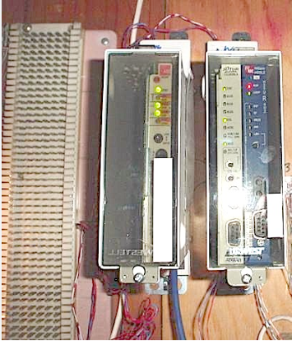
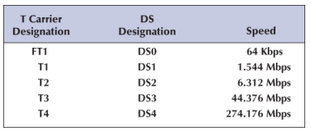
T-Carrier Services:
T-Carrier services are a type of dedicated circuit network technology that provide high-quality digital transmission over leased lines. T-Carrier services are widely used in North America and some other parts of the world. They are part of the T-Carrier system developed by AT&T in the United States. In this service the costs are a fixed amount per month, regardless of how much or how little traffic flows through the circuit.

Slide 13
A T1 circuit (also called a DS1 circuit) provides a data rate of 1.544 Mbps. T1 circuits can be used to transmit data but often are used to transmit both data and voice. In this case, inverse TDM provides twenty-four 64-Kbps circuits. Digitized voice using pulse code modulation (PCM) requires a 64- Kbps circuit, so a T1 circuit enables 24 simultaneous voice channels. Most common carriers make extensive use of PCM internally and transmit most of their voice telephone calls in digital format using PCM, so you will see many digital services offering combinations of the standard PCM 64-Kbps circuit.
A T2 circuit, which transmits data at a rate of 6.312 Mbps, is an inverse multiplexed bundle of four T1 circuits. A T3 circuit allows transmission at a rate of 44.736 Mbps although most articles refer to this rate as 45 megabits per second. This is equal to the capacity of 28 T1 circuits. T3 circuits are becoming popular as the transmission medium for corporate MANs and WANs because of their higher data rates. At low speed, these T3 circuits can be used as 672 different 64-Kbps channels or voice channels. A T4 circuit transmits at 274.176Mbps, which is equal to the capacity of 178T1 circuits.

Slide 14
Fractional T1, sometimes called FT1, offers portions of a 1.544-Mbps T1 circuit for a fraction of its full cost. Many (but not all) common carriers offer sets of 64 Kbps DS-0 channels as FT1 circuits. The most common FT1 services provide 128 Kbps, 256 Kbps, 384 Kbps, 512 Kbps, and 768 Kbps.
In summary, T-Carrier services provide a robust and reliable solution for dedicated circuit networks, especially in regions where they are widely available. They are well-suited for businesses and organizations that require consistent and high-quality communication services for applications like voice, video conferencing, and integrated data networks.

Slide 15
SONET Services:
Synchronous Optical Networking (SONET) is a standardized optical fiber network technology used in telecommunications networks. SONET services provide high-speed, reliable, and scalable data transmission over fiber optic cables. The SONET standard was developed to ensure that different telecommunications equipment from different vendors could work together seamlessly.
SONET networks are synchronous, meaning that data transmission is synchronized to a specific clock signal. This synchronization ensures the precise timing necessary for high-speed data transmission. SONET networks primarily use optical fiber cables for data transmission. Fiber optic technology allows for high bandwidth, low latency, and immunity to electromagnetic interference.
SONET transmission speeds begin at the OC-1 level (optical carrier level 1) of 51.84 Mbps. Each succeeding rate in the SONET fiber hierarchy is defined as a multiple of OC-1, with SONET data rates defined as high as 160 Gbps.

Slide 16
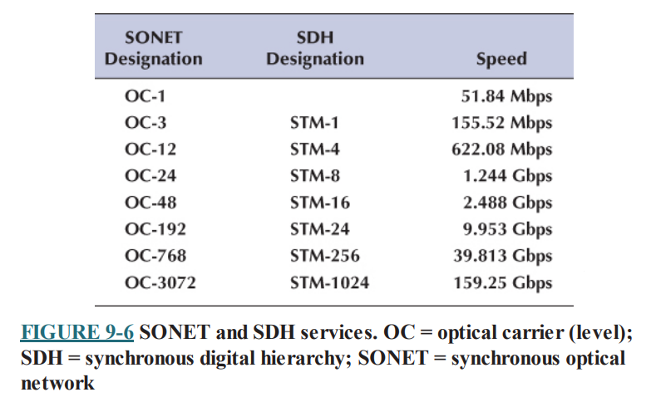
Table presents the commonly used SONET and SDH services. Each level above OC-1 is created by an inverse multiplexer. Notice that the slowest SONET transmission rate (OC-1) of 51.84 Mbps is slightly faster than the T3 rate of 44.376 Mbps.

Slide 17
SONET Services and Benefits:
High Data Rates: SONET services offer high-speed data transmission, making them suitable for applications requiring large bandwidth, such as internet backbone networks, large-scale data centers, and video streaming services.
Reliability: SONET networks are highly reliable. They provide fault detection and restoration capabilities, ensuring rapid recovery in case of network failures. SONET's ring topology allows for automatic rerouting in the event of a link or node failure.
Scalability: SONET networks are scalable, allowing network operators to increase bandwidth easily by adding additional SONET modules or by upgrading to higher (synchronous transport signal) STS levels.
Support for Various Traffic Types: SONET supports various types of traffic, including voice, data, and video, making it versatile for different communication needs.
Compatibility: SONET equipment from different vendors is designed to be compatible, ensuring interoperability and allowing network operators to build networks with equipment from multiple manufacturers.

Slide 18
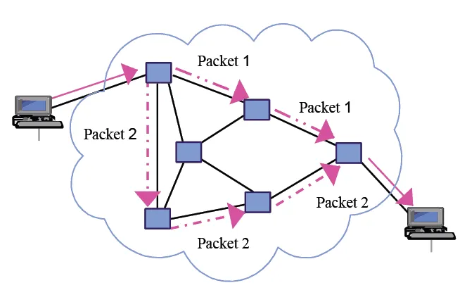
Packet-Switched Network
Packet-switched networks are a type of digital network in which data is broken down into small packets and transmitted independently over the network. These packets contain not only the data being transmitted but also information about the sender, receiver, and the sequencing of the packets. Packet-switching is a fundamental technique used in computer networking, including the Internet.

Slide 19
In packet switching, the network packet is part of a file. The packet includes one letter of that email and the path of the email. It also includes a tiny chip of the letter next to it, in case that letter is lost. The packets are then transferred to the internet. The packets can be returned to many nodes and switches, going all the way around the world if they have to, each going their own different ways as internet traffic conditions allow. The data, sent at nearly the speed of light, makes it to its destination in milliseconds.

Slide 20
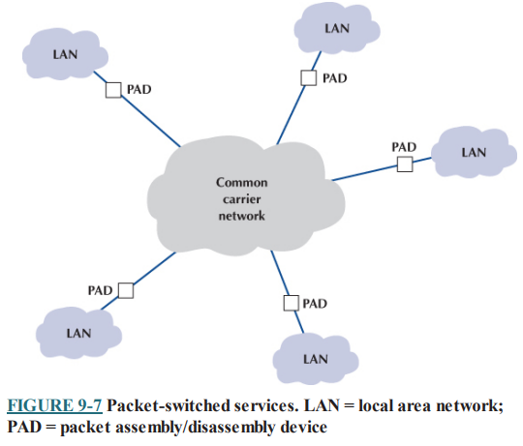
Basic Architecture:
A packet-switched network (PSN) is a kind of computer communications network that sends data in the form of small packets. It allows the sender to send data or network packets to the source and destination node over an internet network channel that is transferred between multiple users and/or applications. A packet-switched is also called a connectionless network, as it does not create an endless connection between a source and destination points.

Slide 21
The user's connection into the network is a packet assembly/disassembly device (PAD), which can be owned and operated by the customer or by the common carrier. The PAD converts the sender's data into the network layer and data link layer packets used by the packet network and sends them through the packet-switched network. At the other end, another PAD reassembles the packets back into the network layer and data link layer protocols expected by the destination (usually Ethernet and IP) and delivers them to the appropriate computer router.
One of the key advantages of packet-switched services is that different locations can have different connection speeds into the common carrier cloud. The PAD compensates for differences in transmission speed between sender and receiver; for example, the circuit at the sender might be 50 Mbps, whereas the receiver only has a 1.5 Mbps circuit. In contrast, a dedicated circuit must have the same speed at both the sender and receiver.
Packet-switched networks enable packets from separate messages with different destinations to be interleaved for transmission, unlike dedicated circuits, which have one sender and one receiver.

Slide 22
The connections between the different locations in the packet network are called permanent virtual circuits (PVCs), which means that they are defined for frequent and consistent use by the network. They do not change unless the network manager changes the network. Some common carriers also permit the use of switched virtual circuits (SVCs), which change dynamically based on traffic, although this is not common. Changing PVCs is done using software, but common carriers usually charge each time a PVC is established or removed.
Packet-switched services are often provided by different common carriers than the one from which organizations get their usual telephone and data services. Therefore, organizations often lease a dedicated circuit (e.g., T1) from their offices to the packet-switched network point of presence (POP). The POP is the location at which the packet-switched network (or any common carrier network, for that matter) connects into the local telephone exchange. There are three types of packet-switched services:
Frame relay
IP services, and.
Ethernet services

Slide 23
Frame Relay Services:
Frame Relay is an efficient data transmission technique used to send digital information such as voice, data, LAN, and WAN traffic quickly and cost-efficiently to many destinations using virtual circuits. Frame Relay is characterized by connection-oriented, permanent or switched virtual circuits (PVC and SVC) at speeds up to 50 Mbps.
It is one of the oldest used packet services in the United States. It uses T carrier and SONET as its wiring, so its speeds are identical to them (e.g., 1.5 Mbps, 45 Mbps, 155 Mbps, and 622 Mbps). It is an unreliable packet service because it does not perform error control. Frame relay checks for errors but simply discards packets with errors. It is up to the software at the source and destination to control for lost messages.
Some common carriers permit users to specify two different types of data rates that are negotiated per connection and for each PVC as it is established. The committed information rate (CIR) is the data rate the PVC guarantees to transmit. If the network accepts the connection, it guarantees to provide that level of service. Most connections also specify a maximum allowable rate (MAR), which is the maximum rate that the network will attempt to provide, over and above the CIR. The circuit will attempt to transmit all packets up to the MAR, but all packets that exceed the CIR are marked as discard eligible (DE). If the network becomes overloaded, DE packets are discarded. So, although users can transmit more data than the CIR, they do so at a risk of lost packets and the need to retransmit them.

Slide 24
IP Services
Many experts predict that in 5 years, IP services will replace frame relay because it is simpler to implement and uses IP, which every organizational already uses. With IP services, the PAD at the sending site takes the outgoing message (which usually is an Ethernet frame containing an IP packet), strips off the Ethernet frame, and uses the IP address in the IP packet to route the packet though the carrier’s packet-switched network to its final destination. The PAD at the destination has an Ethernet port, so a new Ethernet packet is added before the packet enters the customer’s network at the destination. Because the carrier’s packet-switched network uses IP addresses, this network looks and feels like the Internet, although it is a separate network for use only by customers of the carrier.
The data link layer protocol used inside the common carrier’s network is whatever the carrier chooses to use, and the customer never really knows— or cares. Most IP services use multiprotocol label switching (MPLS) as the data link layer protocol, but as long as the customer receives the contracted data speeds and packets are delivered in a reliable manner, the customer never needs to know what protocol(s) are used. IP services use T carrier and SONET as its wiring, so its speeds are identical to them (e.g., 1.5 Mbps, 45 Mbps, 155 Mbps, and 622 Mbps).

Slide 25
Ethernet Services
Although we have seen rapid increases in capacities and sharp decreases in costs in LAN and BN technologies, changes in WAN services offered by common carriers saw only modest changes for many years. That changed in the 2000s with the introduction of several Internet start-ups (e.g., Yipes) offering Ethernet services.
Most organizations today use Ethernet and IP in the LAN and BN environments, yet the WAN packet network services (T carrier, SONET, and frame relay) discussed earlier use different layer 2 protocols. Any LAN or BN traffic, therefore, must be translated or encapsulated into a new protocol and destination addresses generated for the new protocol. This takes time, slowing network throughput. It also adds complexity, meaning that companies must add staff knowledgeable in the different WAN protocols, software, and hardware these technologies require. This is one reason why many common carriers are starting to call these technologies “legacy technologies,” signaling their demise.

Slide 26
Frame relay and IP services use the traditional telephone company WAN networks (i.e., T carrier and SONET) provided by common carriers such as AT&T and BellSouth. In contrast, Ethernet services bypass this network; companies offering Ethernet services have laid their own gigabit Ethernet fiber-optic networks in large cities. When an organization signs up for service, the packet network company installs new fiber-optic cables from their citywide backbone into the organization’s office complex and connects it to an Ethernet switch. The organization simply plugs its network into its Ethernet switch and begins using the service. All traffic entering the packet network must be Ethernet, using IP.
Currently, Ethernet services offer speeds of 1 Mbps–100 Gbps, in 1-Mbps increments, at a lower cost than traditional packet-switched networks. Because this is an emerging technology, we should see many changes in the next few years. Many experts predict this is the future of WANs.

Slide 27
Dedicated network and packet-switched network are two different types of communication networks, each with its own characteristics and applications. Here are the key differences between the two:
Nature of Connection:
Dedicated Network: In a dedicated network, a dedicated physical communication path is established between two devices for the entire duration of their communication. This path is exclusively reserved for the communicating devices, ensuring that no other devices share the network resources during that time.
Packet-Switched Network: In a packet-switched network, data is broken down into smaller packets, and these packets are sent independently across the network. The packets may take different routes to reach the destination, and they are reassembled at the destination.
Resource Usage:
Dedicated Network: Resources, such as bandwidth and infrastructure, are exclusively reserved for the communicating devices. This ensures a consistent and guaranteed level of performance for the duration of the communication.
Packet-Switched Network: Resources are shared among multiple users. Each packet is routed independently, and different packets from the same communication may take different paths through the network based on availability and congestion.

Slide 28
3. Efficiency:
Dedicated Network: While dedicated networks provide reliability and consistent performance, they may be less efficient in terms of resource utilization, especially during periods of low activity.
Packet-Switched Network: Packet-switched networks are generally more efficient in utilizing network resources, as they can dynamically allocate bandwidth based on demand.
4. Examples:
Dedicated Network: Traditional telephone networks (circuit-switched) are an example of a dedicated network. Once a call is established, the dedicated circuit remains open until the call is terminated.
Packet-Switched Network: The Internet is a classic example of a packet-switched network. Data is broken into packets, which are sent independently and may take different routes to reach the destination.
5.Scalability:
Dedicated Network: Adding more devices to a dedicated network may require additional dedicated paths, making it less scalable in some cases.
Packet-Switched Network: Packet-switched networks are generally more scalable, as they can dynamically adjust to accommodate a growing number of users.

Slide 29
Virtual Private Networks
VPN stands for "virtual private network" — a service that helps you stay private online by encrypting the connection between your device and the internet. This secure connection provides a private tunnel for your data and communications while you use public networks.
A Virtual Private Network (VPN) is a technology that creates a secure and encrypted connection over the internet, allowing users to access a private network remotely. It establishes a virtual and protected tunnel between the user's device and the destination server or network, encrypting the data transmitted through this tunnel.
VPNs are commonly used to enhance privacy and security by masking the user's IP address, encrypting their internet traffic, and enabling access to resources on a private network as if they were physically present at the same location, even when connecting from a different location or over a public network like the internet.

Slide 30
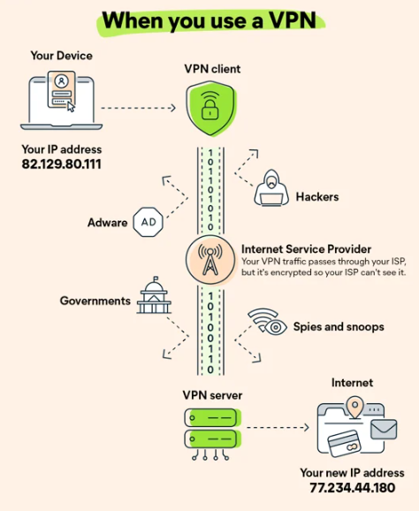
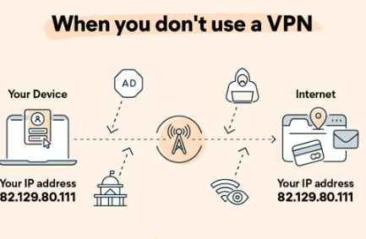

Slide 31
Instead of sending your internet traffic (searches, pages visited, uploads, downloads) directly to your Internet Service Provider (ISP), a VPN first routes your traffic through a VPN server. That way, when your data is finally transmitted to the internet, it appears to come from the VPN server, not your personal device.
Without a VPN, your IP address— a special number unique to your network — is visible to the web. A VPN masks your IP address by acting as an intermediary and rerouting your traffic. It also adds encryption, or a tunnel around your identity, as you connect. The combination of the VPN server and the encryption tunnel blocks your ISP, governments, hackers, and anyone else from spying on you as you navigate the web.
VPNs work on the operating system level, so they reroute all your traffic through other servers. That means all of your online traffic, along with your physical location, stays hidden while you surf the web. When you access a site through a VPN server, the source of your connection is shown as one of the many VPN routers — called a proxy server — not your own. So the owners of the site, and anyone else trying to spy on you, cannot figure out who you are.

Slide 32
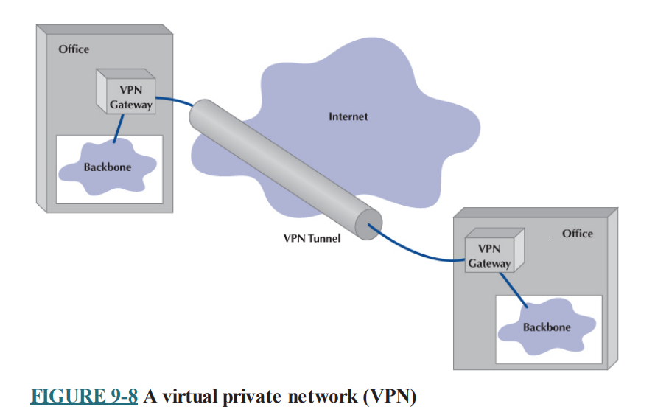
Basic Architecture of VPN:
With a VPN, we first lease an Internet connection at whatever access rate and access technology we choose for each location we want to connect. For example, we might lease a T1 circuit from a common carrier that runs from our office to our Internet service provider (ISP). Or we might use a DSL or cable modem. We pay the common carrier for the circuit and the ISP for Internet access. Then we connect a VPN gateway (a specially designed router) to each Internet access circuit to provide access from our networks to the VPN. The VPN gateways enable us to create PVCs (Permanent Virtual Circuit) through the Internet that are called tunnels as shown in figure:

Slide 33
The VPN gateway at the sender takes the outgoing packet and encapsulates it with a protocol that is used to move it through the tunnel to the VPN gateway on the other side. The VPN gateway at the receiver strips off the VPN packet and delivers the packet to the destination network. The VPN is transparent to the users; it appears as though a traditional packet-switched network PVC is in use.
The VPN is also transparent to the ISP and the Internet as a whole; there is simply a stream of Internet packets moving across the Internet.
VPN software is commonly used on home computers or laptops to provide the same secure tunnels to people working from offsite.
VPNs operate either at layer 2 or layer 3. A layer 2 VPN uses the layer 2 packet (e.g., Ethernet) to select the VPN tunnel and encapsulates the entire packet, starting with the layer 2 packet. Layer 2 tunneling protocol (L2TP) is an example of a layer 2 VPN. A layer 3 VPN uses the layer 3 packet (e.g., IP) to select the VPN tunnel and encapsulates the entire packet, starting with the layer 3 packet; it discards the incoming layer 2 packet and generates an entirely new layer 2 packet at the destination. IPSec is an example of a layer 3 VPN.

Slide 34
The primary advantages of VPNs are low cost and flexibility. Because they use the Internet to carry messages, the major cost is Internet access, which is inexpensive compared with the cost of dedicated-circuit services and packet switched services from a common carrier. Likewise, anywhere you can establish Internet service, you can quickly put in a VPN.
There are two important disadvantages. First, traffic on the Internet is unpredictable. Sometimes packets travel quickly, but at other times, they take a long while to reach their destination. Although some VPN vendors advertise quality of service (QoS) capabilities, these apply only in the VPN devices themselves; on the Internet, a packet is a packet. Second, because the data travel on the Internet, security is always a concern. Most VPNs encrypt the packet at the source VPN device before it enters the Internet and decrypt the packet at the destination VPN device.

Slide 35
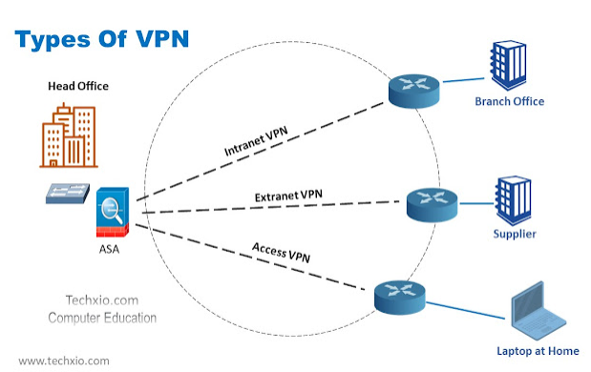
VPN Types
Three types of VPNs are in common use:
Intranet VPN: used to connect computers of two different sites of a company with a VPN device
Extranet VPN: used to connect computers of two different sites of two partner companies with a VPN device connected at each end.
Access VPN: used to connect internet users to the network of the company.

Slide 36
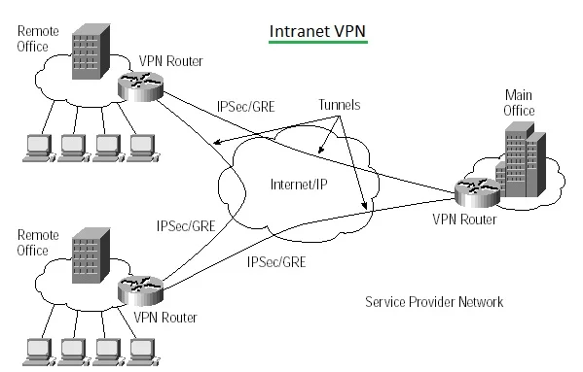
Intranet VPN
An internal VPN, also known as an Intranet VPN or a Site-to-Site VPN, is a type of Virtual Private Network used to connect multiple locations of a company or organization securely over the internet. It allows different branches, offices, or data centers within the same organization to communicate with each other as if they were on the same private network, even if they are geographically distributed.
Internal VPNs play a vital role in modern businesses, enabling seamless and secure communication between geographically dispersed offices. They are an essential component of corporate network infrastructures, fostering collaboration and efficiency among employees in different locations.

Slide 37
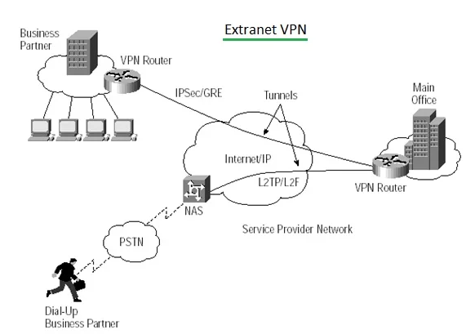
Extranet VPN:
An Extranet VPN (Virtual Private Network) is a type of VPN that enables secure communication and data exchange between different organizations, such as business partners, suppliers, or clients, over the internet. It extends the concept of a corporate intranet, allowing authorized users from external organizations to access specific resources on a company's network securely. Extranet VPNs provide a secure way to share sensitive information, collaborate on projects, and conduct business transactions without compromising security.
Extranet VPNs facilitate collaborative efforts between organizations. Businesses can securely share files, documents, applications, and other resources with their partners. This collaboration is particularly valuable for joint ventures, supply chain management, and collaborative projects.

Slide 38
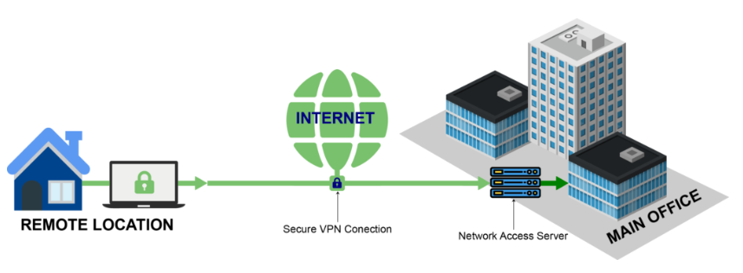
Access VPN
Access VPN typically refers to a VPN (Virtual Private Network) designed to provide secure and remote access to specific internal resources or networks. Access VPNs allow users to connect to a private network, such as a corporate intranet, over the internet securely. These VPNs are widely used by remote employees, traveling professionals, and telecommuters who need secure access to company resources from outside the organization's physical premises.

Slide 39
Employees have access to the network and all the resources on it in the same way as employees physically located on the network. The user uses VPN software on his or her computer to connect to the VPN device at the office. The VPN gateway accepts the user's log-in, establishes the tunnel, and the software begins forwarding packets over the Internet. Compared with a typical ISP-based remote connection, the access VPN is a more secure connection than simply sending packets over the Internet.

Slide 40
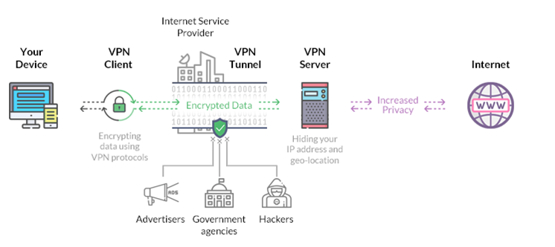
How VPN works?
- A VPN works by routing a device's internet connection through a private service rather than the user's regular internet service provider (ISP).
- The VPN acts as an intermediary between the user getting online and connecting to the internet by hiding their IP address.
- Using a VPN creates a private, encrypted tunnel through which a user's device can access the internet while hiding their personal information, location, and other data. All network traffic is sent through a secure connection via the VPN. This means that any data transmitted to the internet is redirected to the VPN rather than from the user's computer.
- When the user connects to the web using their VPN, their computer submits information to websites through the encrypted connection created by the VPN. The VPN then forwards that request and sends a response from the requested website back to the connection.

Slide 41
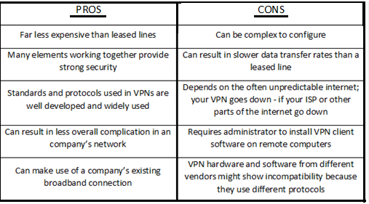
Pros and Cons of VPN

Slide 42
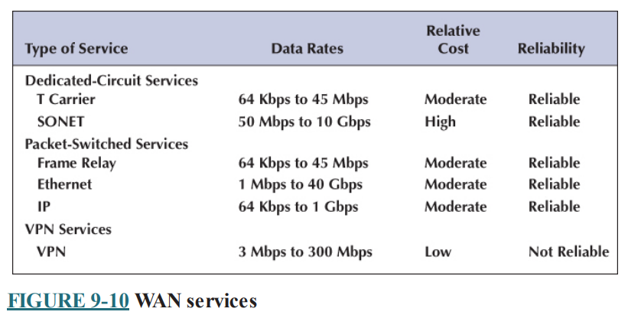
The Best Practice WAN Design
Developing best practice recommendations for WAN design is more difficult than for LANs and backbone networks because the network designer is buying services from different companies rather than buying products. The relatively stable environment enjoyed by the WAN common carriers is facing sharp challenges by VPNs at the low end and Ethernet at the high end.
Figure summarizes the major services available today for the WAN, grouped by the type of service. A few patterns should emerge from the table.

Slide 43
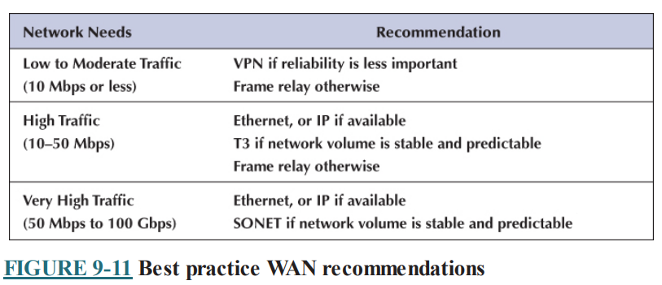
For small WANs with low-to-moderate data transmission needs, VPN services are a good alternative, provided the lack of reliability is not a major issue. Otherwise, frame relay is a good choice.

Slide 44
For networks with high data transmission needs (10–50 Mbps) there are several distinct choices. If cost is more important than reliability, then a VPN is a possible choice. If you need flexibility in the location of your network connections and you are not completely sure of the volume of traffic you will have between locations, frame relay, or IP are good choices. If you have a mature network with predictable demands, then T3 is probably a good choice.
For very-high-traffic networks (50 Mbps–100 Gbps), Ethernet is a dominant choice. And again, some organizations may prefer the more mature SONET services, depending on whether the greater flexibility of packet services provides value or a dedicated circuit makes more sense.

Slide 45
Designing a Wide Area Network (WAN) requires careful planning and consideration of various factors to ensure optimal performance, security, and scalability. Here are some best practices for WAN design:
1.Understand Business Requirements:
Collaborate with Stakeholders: Involve key stakeholders to understand their current and future requirements. This includes departments like IT, finance, and operations.
Application Requirements: Identify the applications and services that will be accessed over the WAN. Different applications may have varying bandwidth and latency requirements.
2. Bandwidth Planning:
Traffic Analysis: Conduct a thorough analysis of network traffic patterns. Identify peak usage times and the types of data being transmitted.
Scalability: Design the network with scalability in mind. Choose WAN technologies and service plans that can be easily upgraded to accommodate future growth.

Slide 46
3. Redundancy and High Availability:
Redundant Connections: Implement redundant WAN connections to ensure high availability. Use diverse paths and providers to minimize the risk of single points of failure.
Failover Mechanisms: Implement automatic failover mechanisms to switch traffic to backup links in case of a primary link failure.
4. Security:
Encryption: Use encryption protocols (like IPsec) to secure data transmitted over the WAN, especially for sensitive and confidential information.
Firewalls and Intrusion Detection/Prevention Systems: Deploy firewalls and intrusion detection/prevention systems to protect the WAN from unauthorized access and attacks.

Slide 47
5. Quality of Service (QoS):
Prioritize Traffic: Implement Quality of Service policies to prioritize critical applications over less time-sensitive traffic. This ensures that essential applications receive the necessary bandwidth and low latency.
Traffic Shaping: Use traffic shaping to control the flow of traffic, preventing network congestion and optimizing performance for all applications.
6. WAN Optimization:
Compression and Caching: Implement compression and caching techniques to reduce the amount of data transmitted over the WAN, optimizing bandwidth usage.
Content Delivery Networks (CDNs): Utilize CDNs to cache content closer to end-users, reducing latency and improving the delivery of web applications and content.

Slide 48
7. Monitoring and Management:
Network Monitoring Tools: Deploy network monitoring tools to continuously monitor the WAN's performance, bandwidth utilization, and security. Promptly address issues as they arise.
Centralized Management: Implement centralized management solutions to efficiently configure, monitor, and manage WAN devices and policies.
8. Documentation and Disaster Recovery:
Documentation: Maintain detailed documentation of the WAN design, configurations, IP addressing schemes, and security policies. This documentation is vital for troubleshooting and future expansions.
Disaster Recovery: Develop a robust disaster recovery plan that includes backup connections, data replication, and failover procedures to ensure business continuity in case of network failures.

Slide 49
9. Compliance and Regulations:
Compliance: Ensure that the WAN design complies with industry regulations and data protection laws applicable to your organization. This is especially crucial for industries like healthcare and finance.
10. Regular Updates and Training:
Regular Updates: Keep WAN equipment and software up-to-date with the latest patches and firmware releases to address security vulnerabilities and enhance performance.
Training: Provide training to IT staff responsible for managing the WAN. Ensure they are well-versed in best practices, security protocols, and troubleshooting techniques.

Slide 50
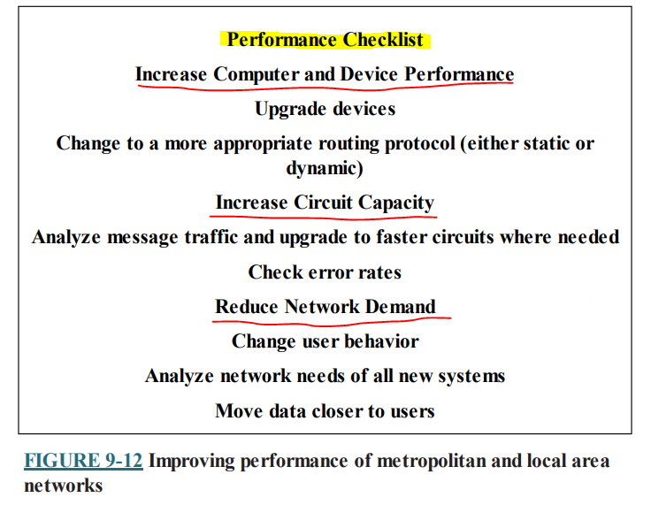
Improving WAN Performance
Improving WAN performance is crucial for businesses, especially when dealing with remote offices, cloud applications and data intensive tasks. Improving the performance of WANs is handled in the same way as improving LAN performance.
We begin by checking the devices in the network, by upgrading the circuits between locations, and by changing the demand placed on the network.

Slide 51
Improving Device Performance
In some cases, the key bottleneck in the network is not the circuits; it is the devices that provide access to the circuits (e.g., routers). One way to improve network performance is to upgrade the devices and computers that connect backbones to the WAN. Most devices are rated for their speed in converting input packets to output packets (called latency). Not all devices are created equal; some vendors produce devices with lower latencies than others.
Another strategy is examining the routing protocol, either static or dynamic. Dynamic routing will increase performance in networks that have many possible routes from one computer to another and in which message traffic is “bursty”—that is, in which traffic occurs in spurts, with many messages at one time, and few at others. But dynamic routing imposes an overhead cost by increasing network traffic. In some cases, the traffic and status information sent between computers accounts for more than 50% of all WAN message traffic. This is clearly a problem because it drastically reduces the amount of network capacity available for users’ messages. Dynamic routing should use no more than 10–20% of the network’s total capacity.

Slide 52
Improving Circuit Capacity:
The first step is to analyze the message traffic in the network to find which circuits are approaching capacity. These circuits then can be upgraded to provide more capacity. Less-used circuits can be downgraded to save costs. A more sophisticated analysis involves examining why circuits are heavily used. The capacity may be adequate for most traffic but not for meeting peak demand. One solution may be to add a packet-switched service that is used only when demand exceeds the capacity of the dedicated-circuit network. The use of a service as a backup for heavy traffic provides the best of both worlds. The lower-cost dedicated circuit is used constantly, and the backup service is used only when necessary to avoid poor response times.
Sometimes a shortage of capacity may be caused by a faulty circuit. As circuits deteriorate, the number of errors increases. As the error rate increases, throughput falls because more messages have to be retransmitted. Before installing new circuits, monitor the existing ones to ensure that they are operating properly or ask the common carrier to do it.

Slide 53
Reducing Network Demand
There are many ways to reduce network demand. One step is to require a network impact statement for all new application software developed or purchased by the organization. This focuses attention on the network impacts at an early stage in application development. Another simple approach is to use data compression techniques for all data in the network.
Another more difficult approach is to shift network usage from peak or high cost times to lower-demand or lower-cost times. For example, the transmission of detailed sales and inventory reports from a retail store to headquarters could be done after the store closes. This takes advantage of off-peak rate charges and avoids interfering with transmissions requiring higher priority such as customer credit card authorizations.
The network also can be redesigned to move data closer to the applications and people who use them. This also will reduce the amount of traffic in the network. Distributed database applications enable databases to be spread across several different computers. For example, instead of storing customer records in one central location, you could store them according to region.

